Slide 1

Curfew e-Pass Management System
Developed in PHP & MySQL
BY
Niharika K(1DT19CS094)
Madhu Sudhan S(1DT19CS074)

Slide 2
INTRODUCTION
Curfew Pass Management system is a web-based technology that will manage the records of pass which is issue by administrative and also help to provide online curfew e-pass to people who need to travel compulsory. Curfew Pass Management System is an automatic system which delivers data processing in very high speed in systematic manner.
In CPMS we use PHP and MySQL database. This is the project which keeps records of the pass which is issued by administrative. CPMS has three module i.e. admin, Subadmin, and User.
Admin
Sub-Admin
User

Slide 3
IDEA OF IMPLEMENTATION
ADMIN MODULE
Secure admin login system
Dashboard: In this section, admin can briefly view the total number of category and how many pass will be generated in one day, yesterdays and last seven’s days.
Sub-admin: In this section, Admin can create and manage the sub-admin(Add, update).
Category: In this section, admin can manage category (add/update).
Add Pass: In this section, admin add pass.
Manage Pass: In this section, admin can update pass and take print of that pass.
Reports: In this section, admin can generate pass reports between two dates and also generates report sub admin wise.
Search: In this section, admin can search a particular pass by pass number.
Admin Profile: In this section, Admin can update their profile details.
Change password: In this section, Admin can change their change password.
Admin can also recover their password..

Slide 4
SUB-ADMIN
Dashboard: In this section, Sub-admin can briefly view how many pass will be generated in one day, yesterdays and last seven’s days.
Add Pass: In this section, Sub-admin add pass.
Manage Pass: In this section, Sub-admin can update pass and take print of that pass.
Reports: In this section, Sub-admin can generate pass reports between two dates report.
Search: In this section, Sub-Admin can search a particular pass by pass number.
Sub-Admin Profile: In this section, Sub-Admin can update their profile details.
Change password: In this section, Sub-admin can change their change password.
User Module
User can visit home page and search pass details by entering pass number.

Slide 5
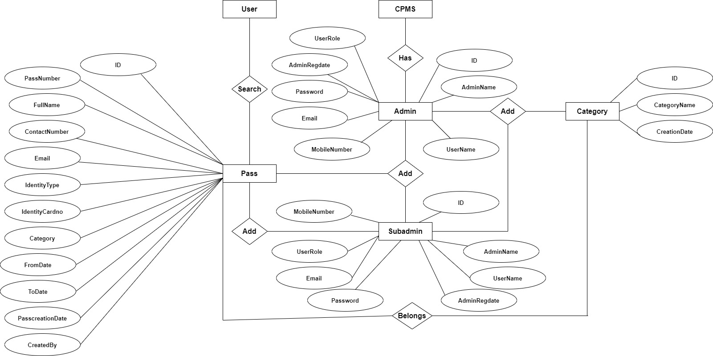
ER Diagram

Slide 6
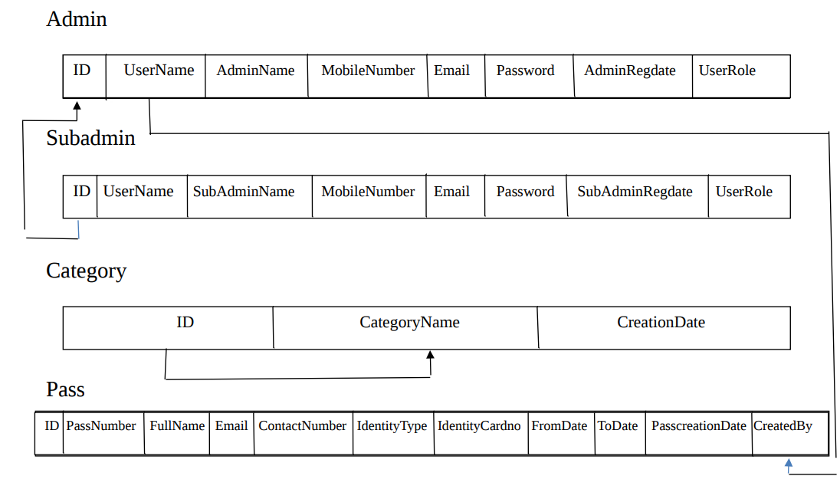
RELATIONAL SCHEMA

Slide 7
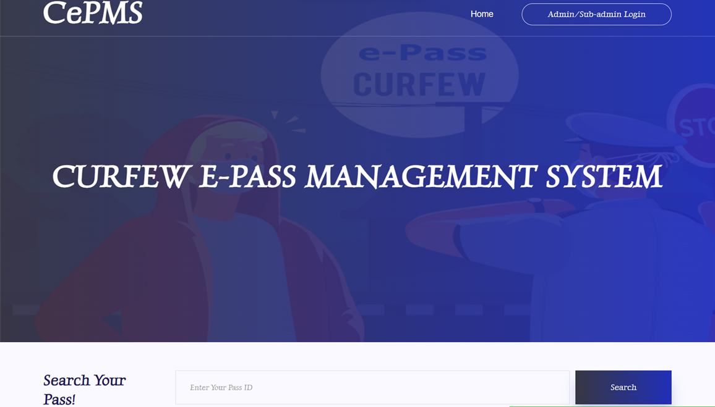
PROJECT SCREENS
Home Page

Slide 8
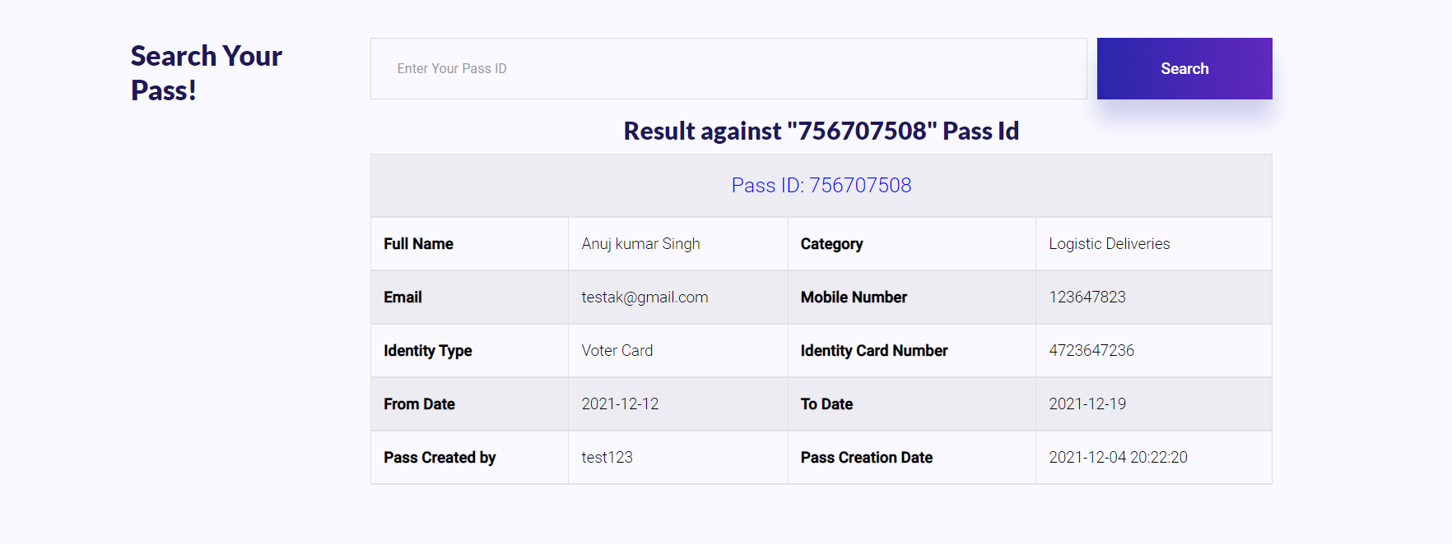
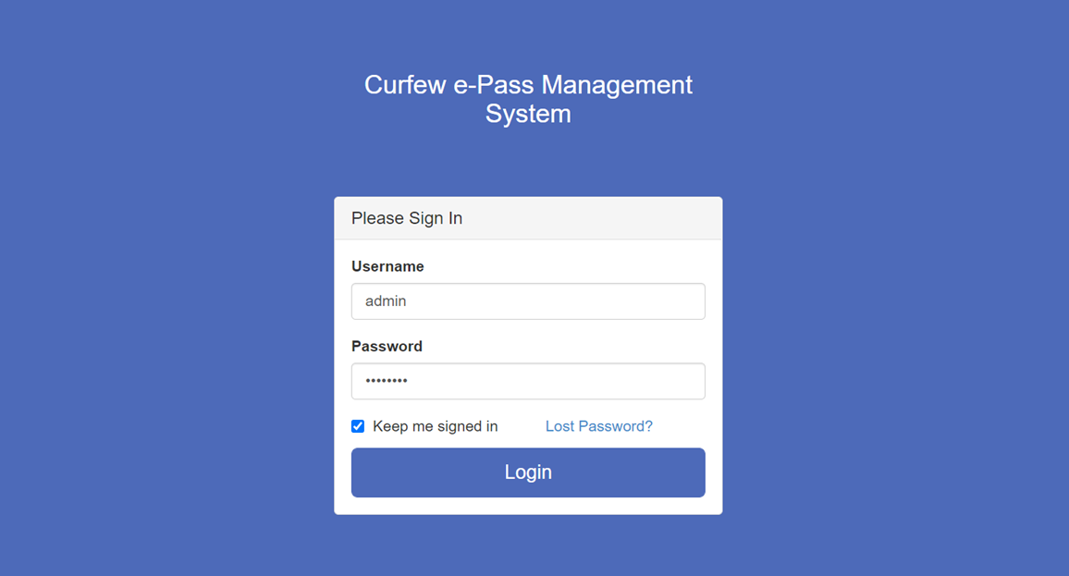
Admin login

Slide 9
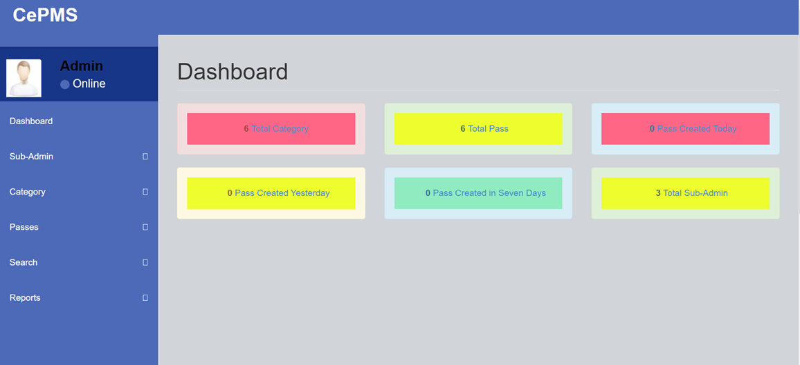
Dashboard

Slide 10
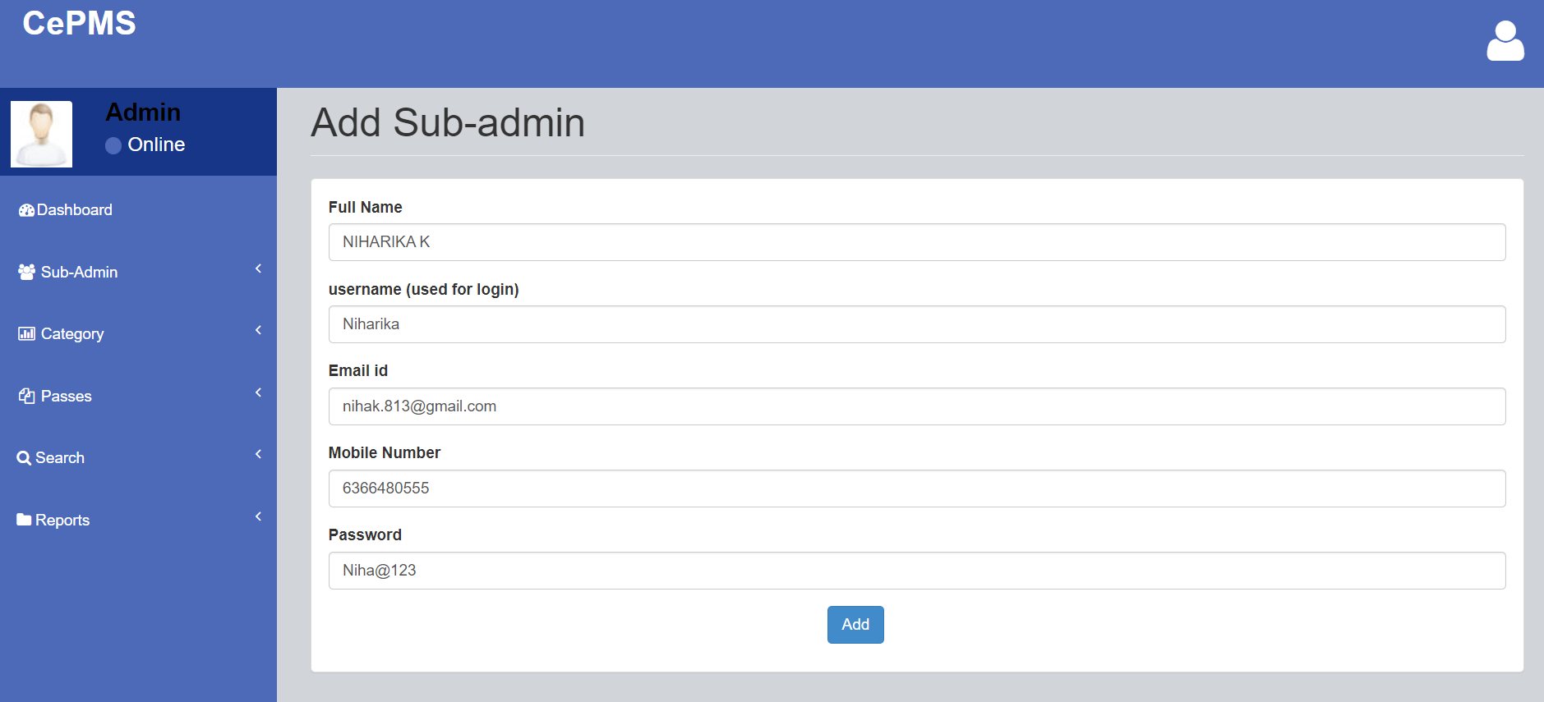
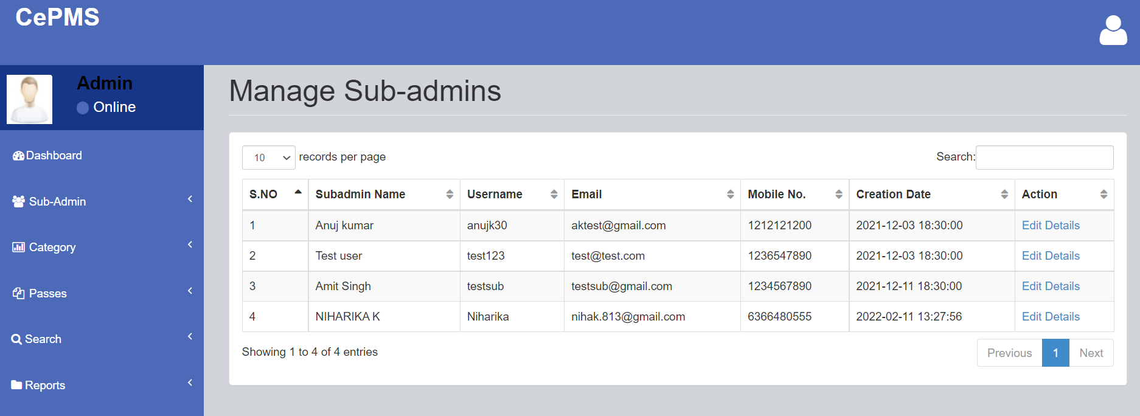
Admin Profile
Manage sub-admin

Slide 11
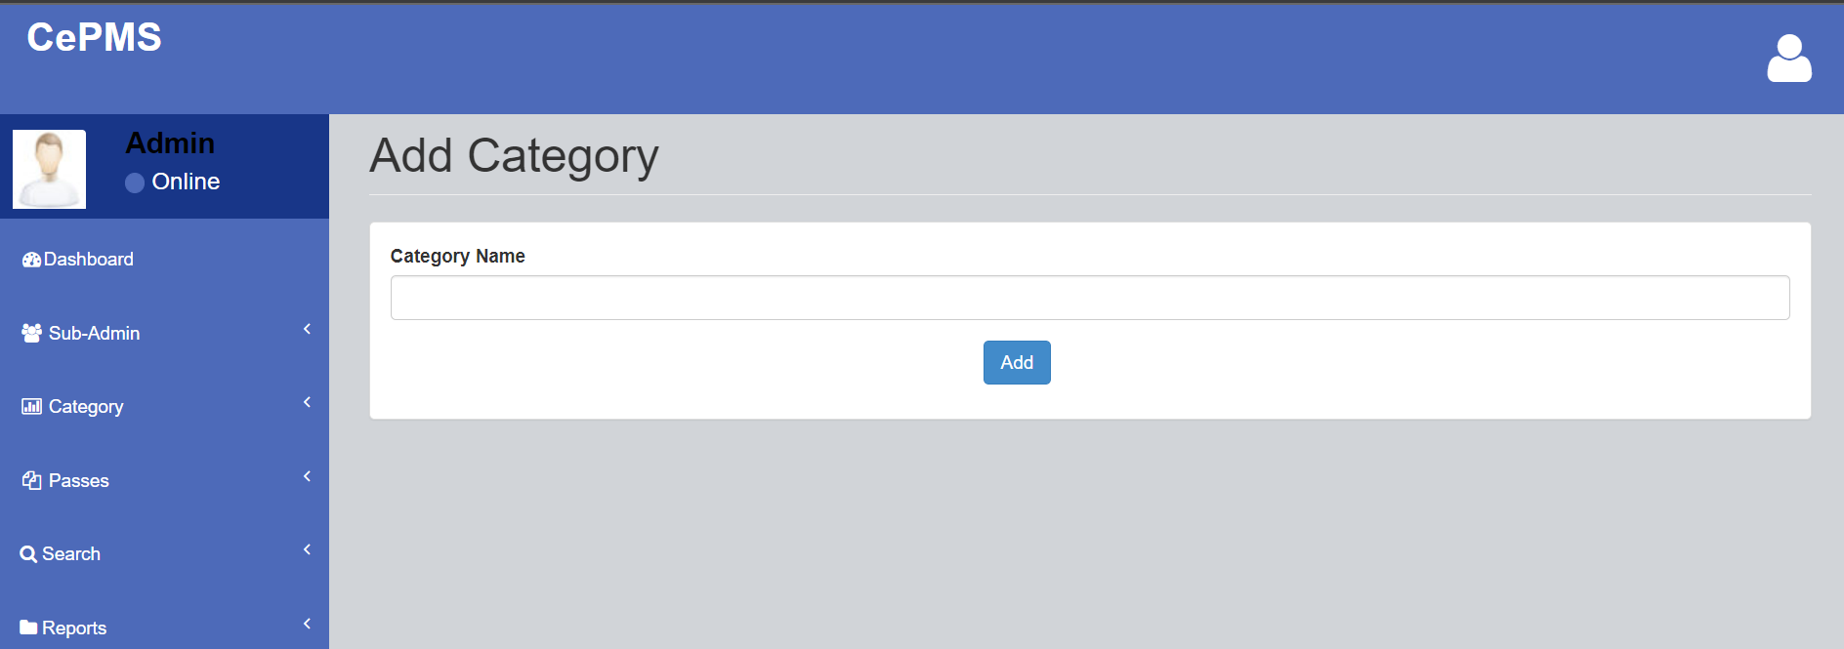
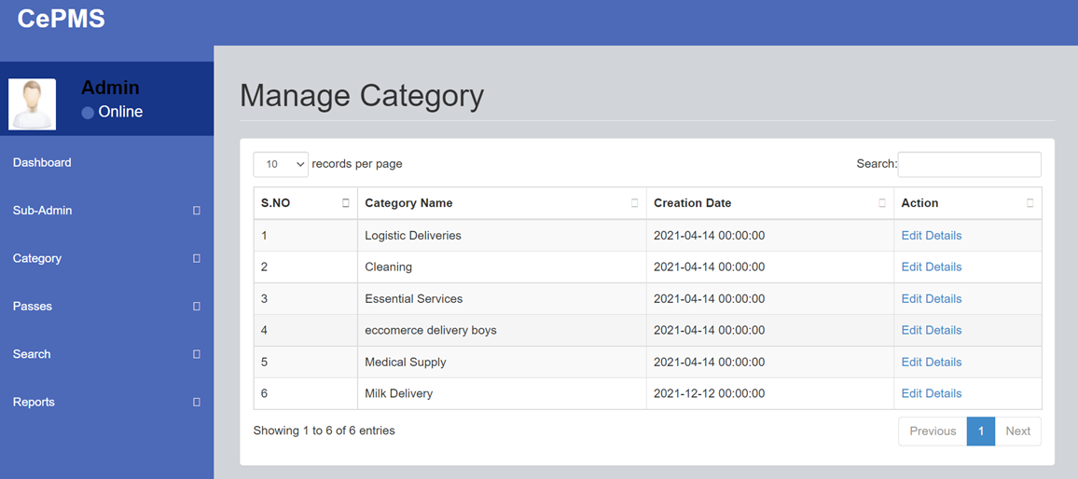
Add Category
Manage Category

Slide 12
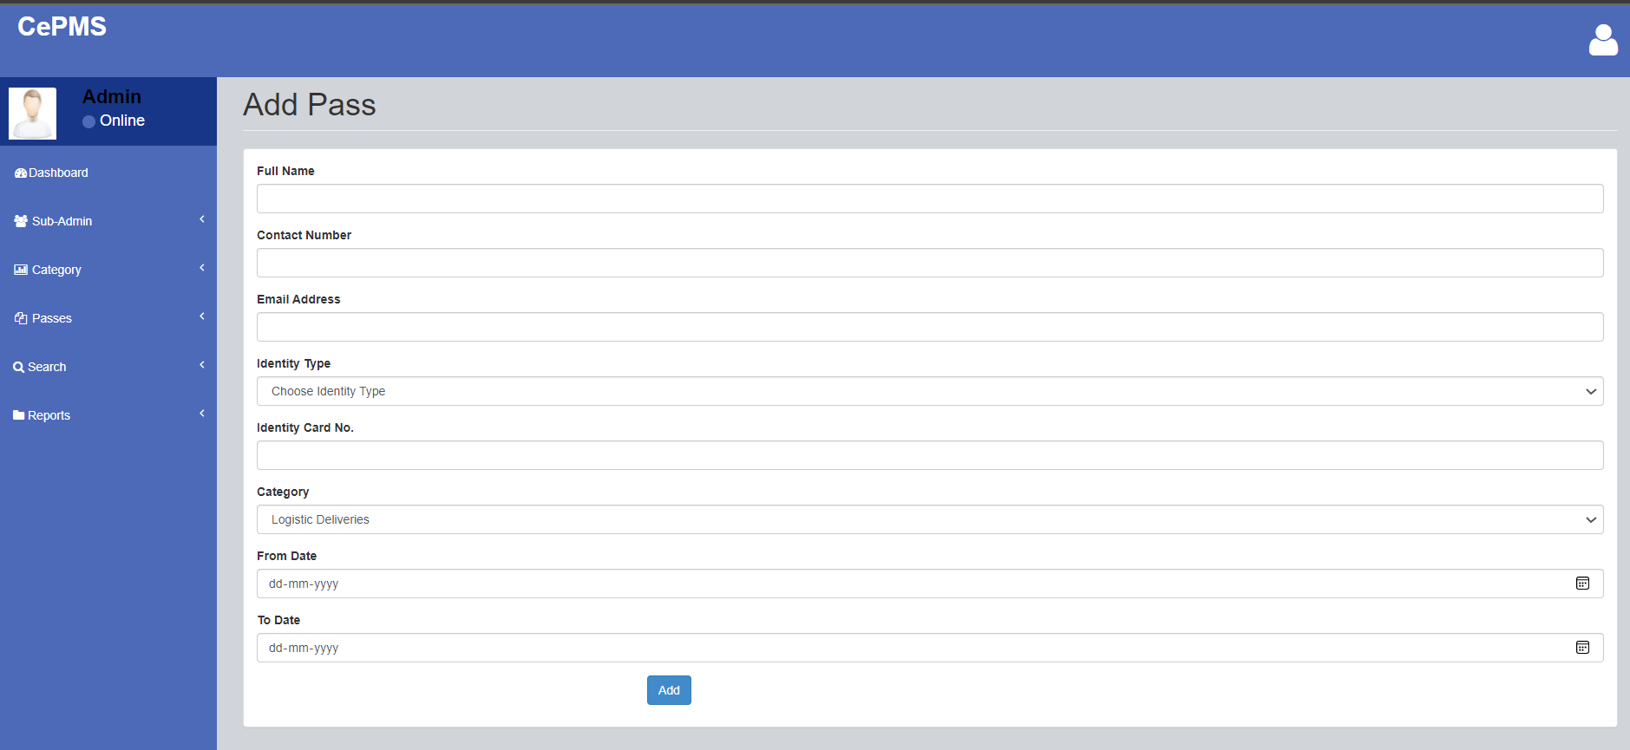
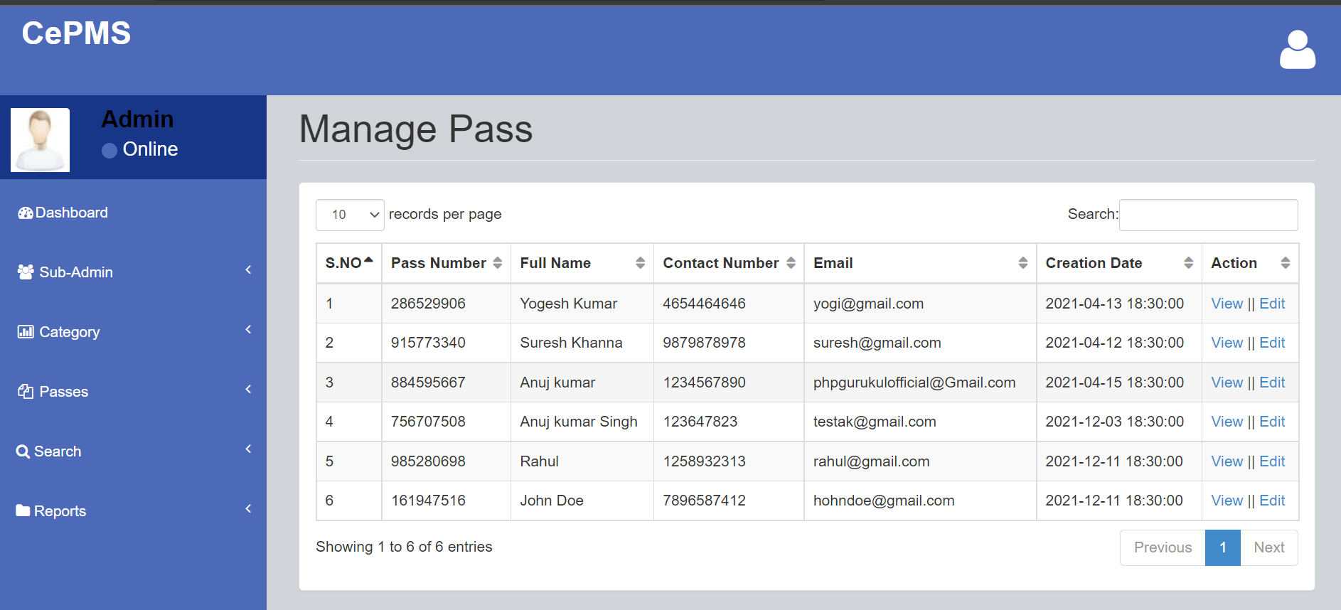
Add Pass
Manage Pass

Slide 13
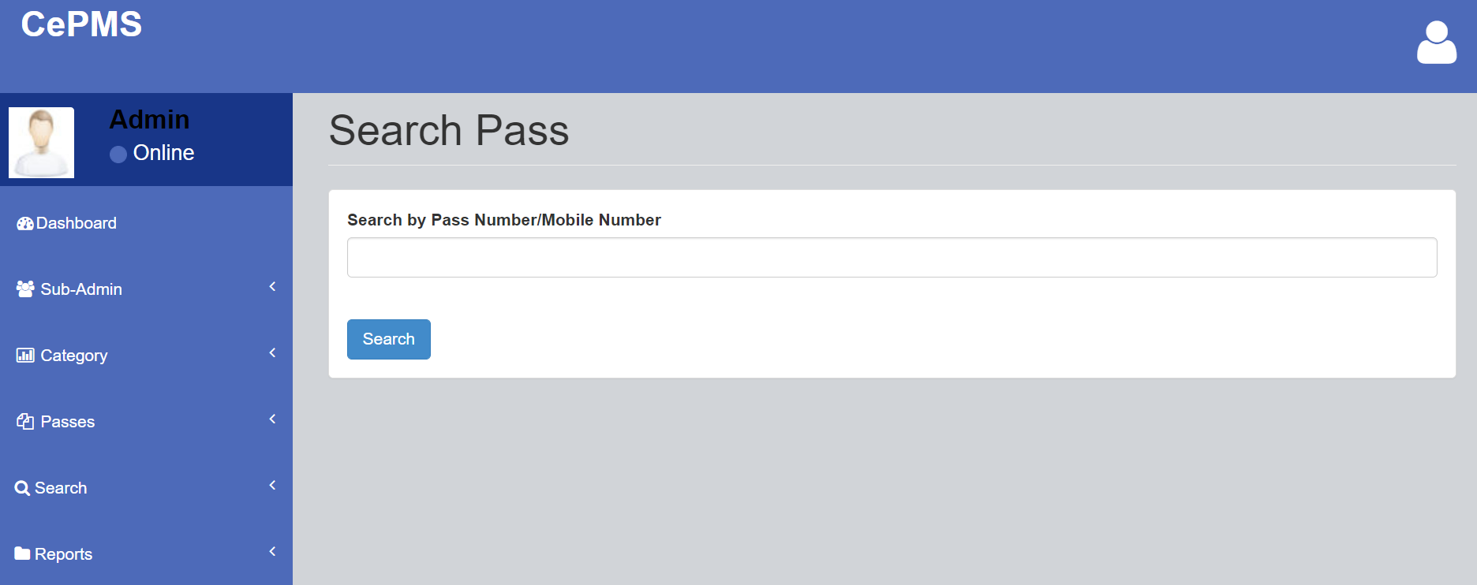
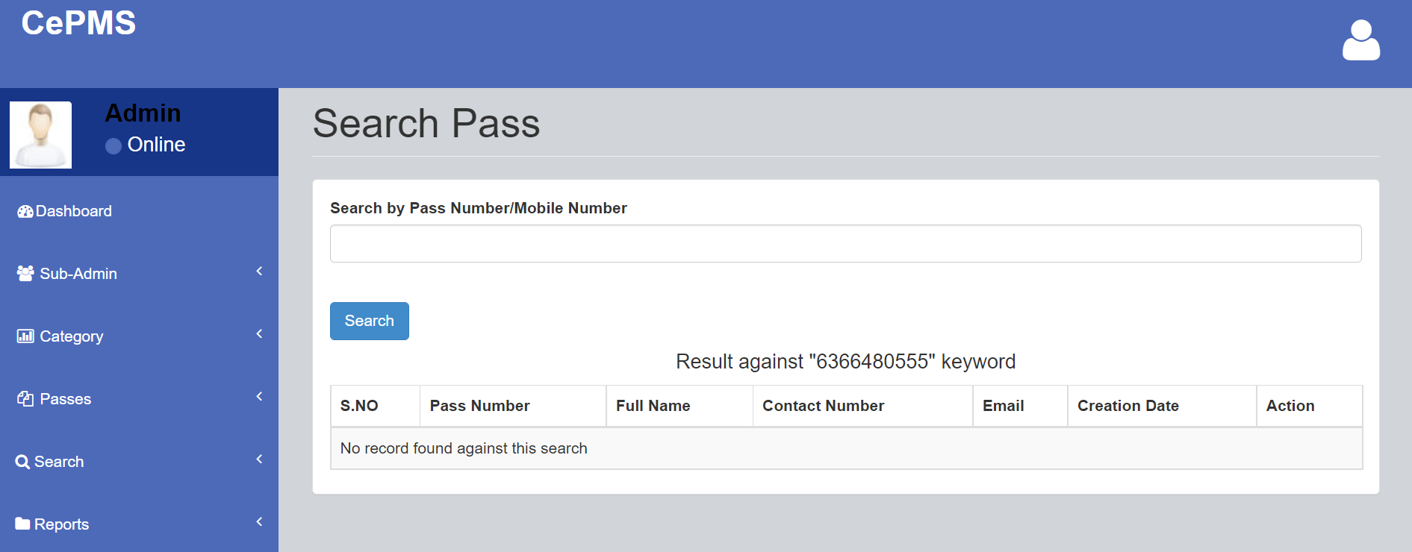
Search Pass
Search Pass

Slide 14
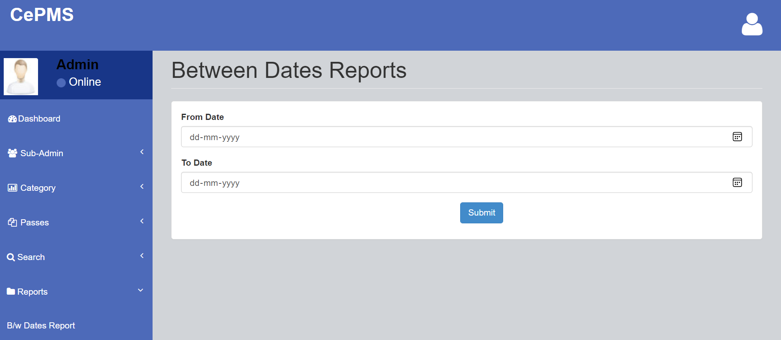
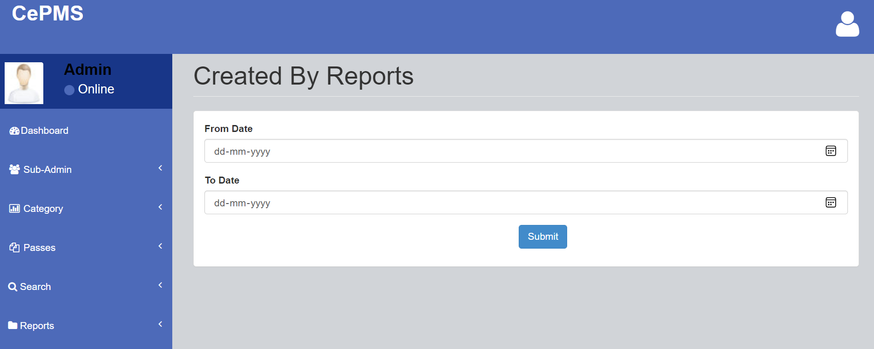
Between Dates Reports
Created By Reports

Slide 15
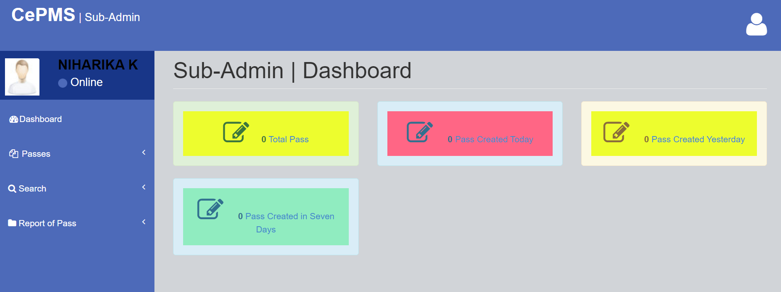
Sub-Admin|Dashboard

Slide 16
CONCLUSION
The Curfew Pass Management System is a great improvement over the manual system which uses lots of manual work. The computerization of the system speeds up the process. This system was thoroughly checked and tested with dummy data and found to be very reliable.
FEATURES INCULDE
It is fast, efficient and reliable.
Avoids data redundancy and inconsistency
Web-based
Any number of users can use it
Provides more security and integrity to data

Slide 17
REFERENCES
For PHP
https://www.w3schools.com/php/default.asp
https://www.sitepoint.com/php/
https://www.php.net/
For MySQL
https://www.mysql.com/
http://www.mysqltutorial.org
For XAMPP
https://www.apachefriends.org/download.html

Slide 18
Thank You!

